Slide 1
ENTERPRISE LEVEL DISPLAY ADVERTISING
By: Ben Smith

Slide 2
Agenda
What’s with all the acronyms?
Flavors of Retargeting
Prospecting Strategies
Advanced Video Advertising
Case Study

Slide 3
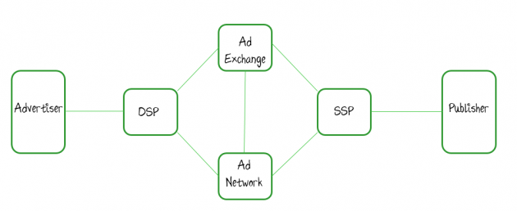
Acronyms
Programmatic: Using an automated system to make media buying decisions instead of doing it manually
RTB: Real Time Bidding. As a general concept, it's basically what it says in the name. Bidding in real time on an impression by impression basis for display inventory.
DSP: Demand Side Platform. This is the tool which advertisers or agencies (on behalf of advertisers) use to set up their programmatic display campaigns; i.e. Strategy, targeting methods to reach the right users, bids, etc.
SSP: Supply-Side Platform or Sell-Side Platform. It's a technology platform that publishers can use to manage their inventory more efficiently with the idea of maximizing revenue. It's basically the same as a DSP but for publishers.

Slide 4





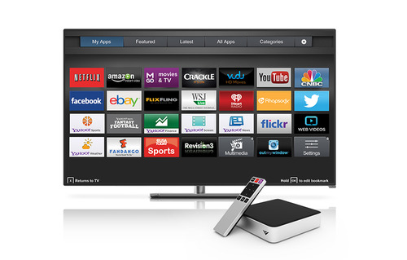


One Audience, every channel, every buying model, One Platform
Display
Video
Social
Mobile
Native
Every major exchange and SSP
Exclusive access inventory
Open and Private Marketplace
12+ ad formats
Expandables
Cross-channel targeting and measurement
Actual player size targeting
Auto-optimize to completion rate and viewability
Advanced TV
Facebook Exchange
Right hand rail
Newsfeed
In-App and Mobile web
Inventory from Apple, Google, and Twitter
Cross-device retargeting
Integrations with TripleLift, 33 Across and GumGum
Facebook Newsfeed
Disqus integration pending completion

Slide 5













Access Every Major Ad Exchange
OTHER
A Single Network is Not Enough
Access to every major exchange and SSP including the Facebook Exchange (FBX) and News Feed
2 MILLION QPS
12 IAB Standard Units, including high impact
Scale in 150+ countries
Other:
Admeta
Adscale
Adskom
Beanstock Media
CCI
Centro Exchange
Falk Real Time
GumGum
Improve Digital
Xaxis Marketplace
Zedo

Slide 6











































Supply, Data, & Tech Partners
Inventory Partners
Display/Video/Mobile/TV/Social
Data Partners
Other Partners

Slide 7
RETARGETING
Advanced Strategies

Slide 8

How To Apply Display Retargeting
When a website has in excess of at least 5000 estimated Unique Visitors per Month. Enterprise level retargeting requires a robust cookie pool in order to achieve successful campaign results. Only 7-10% of the Uniques can be used toward a Monthly Retargeting budget
Performance Driven Campaigns demanding specific ROI Goals
CPM, CPC & CTR Rates take on less importance as Conversions and Revenue drive the KPIs. Retargeting strategies force higher CPM's and CPC's and tend to draw a lower CTR, mainly because higher bids are forced due to limited retargeted cookies
No focus on the Geo as we only want to capture users who have shown intent when they initially visited the client’s site
Retargeting can also be used as a Branding Strategy as users are delivered multiple retargeting ads, ensuring that the Brand is top of mind
Retargeting is key for Cross-Selling campaigns

Slide 9
ATD Leverage Enterprise Strategies
Site Wide Retargeting
Retarget Users anywhere on the internet. Access all the exchanges and cast a very large net in order to reach your valued customer.
Shop Cart Abandoner Retargeting
Specifically retarget users who didn’t fully complete the conversion funnel. One of the most effective performance driven strategies
FBX RHR (Right Hand Rail) and Newsfeed Retargeting
Retargets users while on their Facebook page. The ad will appear on the RHR and/or Newsfeed sections of FB
You Tube Retargeting
Retargets users while they appear on YouTube. Use of Video and Free Companion Ads for this strategy
Live Ramp Email Retargeting
Connecting client’s CRM data to Liveramp’s massive database, matching email addresses, physical addresses, etc to first party data. No emails need to be deployed via this method
Household Extension Retargeting
Retargets users via their IP address. Connect with all family members across all devices. Ie: Tablet, Smartphone, Laptop, etc
Outlook & Yahoo Retargeting
Retargets users while they appear on their Outlook/Yahoo Webmail. Outlook is a highly coveted group as they migrated as previous Hotmail users. Yahoo uses a larger ad unit 300x600
First Bucket Retargeting
Specifically retarget users who didn’t fully complete the conversion funnel. One of the most effective performance driven strategies. Bidding specifically and more aggressively on cookies born within the first 12 hours of being captured, as they tend to be the most coveted and reflective of best ROI
Private Marketplace (PMP) Retargeting
Retargeting users while they appear on Premium Inventory relevant to the client's demo specifically via the Private Marketplace universe

Slide 10




What Is Predictive Audience and Look Alike Modeling?
How?
The Targeting Algorithm uses Pixels (Retargeting or Conversion) placed on an advertiser’s site and Utilizes Look-alike Modeling to find 3rd party data Segments to Build Audience comprised of High-Value Users. ATD leverages Look A Like Modeling through the Conversion Audience and the Site Retargeting Audience. A total of 30,000 cookies is needed to launch LAL
Predictive Audience Targeting applies algorithmic learning to 3rd party data to build an audience comprised of users who matter for achieving an ad group’s
configured goals
Added to Targeting
Data Pool
Filter
Discarded
The algorithm also deactivates underperforming segments and constantly adjusts the predicted model to reach the most
valuable audience

Slide 11

Audience Predictor
Audience Predictor is an automated lookalike model that will find more users that look like your target audience. This model generates in two different ways for optimal audience analysis.
3rd Party Data Element
Lookalike model finds highly indexing audience segments.
Target overlaps frequently with these three data segments, for example.
BlueKai: Married
Lotame: Domestic Automobile
Experian: Graduate Degree
Custom Advertiser Element
Known PPB audience segment
Custom Advertiser Element looks at PPB’s first party data. Then it finds individual users who have similar behavior patterns.
10K PPB visitors had following behavior pattern:
--3-4 visits to blog websites in 1 week
--AND: 1 visit to travel booking website
Based on this behavior pattern, there are 500K users that have similar behavior patterns that will be targeted immediately by Audience Predictor.
Woman reviewing information about printing options for her company.

Slide 12


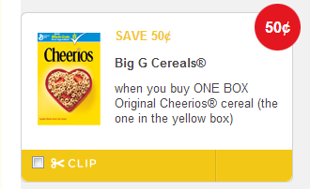







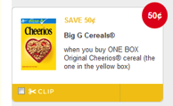
Household Extension
1st party audiences can be targeted across all household devices via Household Extension,
leveraging IP targeting to reach customers and families.
Ad also reaches husband on laptop
Wife visits Cheerios.com to look for promotions and gets retargeted
Ad reaches daughter (influencer) on phone
Ad reaches grandmother (influencer) on tablet

Slide 13

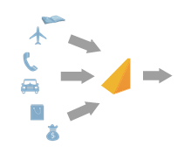
LiveRamp – CRM Retargeting
THE PROBLEM:
Marketing organizations today have a wealth of transactional and CRM data tied to email and postal addresses. But this data is silo-ed from their online marketing initiatives and can only be used to personalize email and direct mail campaigns
THE SOLUTION:
Send your Data Securely to LiveRamp. Email Data Matched to Live Ramp’s User Name Database
LiveRamp matches data to Online Browsers. Only Pay for the Data that Matches with LiveRamp 1st Party Data
LiveRamp Syncs your Data Directly. Cost of CPM added as Revenue Share Percentage.
Email | Address | LifetimeValue | Purchased in last 6 months
alex@gmail.com | 123 Main St. | $2,000 | No
anne@gmail.com | 1757 Elm St. | $30,000 | No
joe@hotmail.com | 667 Mission St. | $500 | Yes
lisa@hotmail.com | 20 Maiden Ln. | $1500 | No
gina@gmail.com | 375 George St. | $20,000 | Yes
mark@gmail.com | 598 Howard St. | $100,000 | Yes

Slide 14
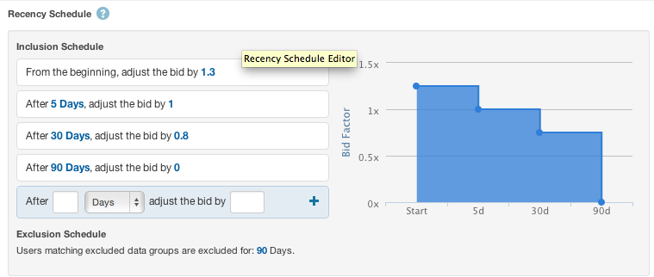
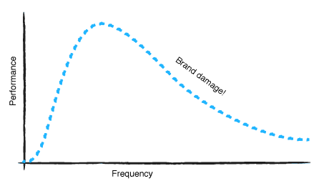
Uniquely Optimize Retargeting Campaigns
  Building Customizable Recency Schedules
  Bidding higher/lower for recent/older prospects
Recency Flexibility
  Recency capping: Avoid displaying ads to users 30+ days after they visit your website
Frequency Capping
  Controls how many Retargeted Impressions are being delivered to the User in a Specific Time Period

Slide 15



Stop
Retargeting Burnout
I ALREADY HAVE THOSE SHOES!!!
Avoid retargeting systems that pummel users with ads, wasting an advertiser’s money
on users who have already converted and causing them to feel “followed”
SHOE SALE!
SHOE SALE!
SHOE
SALE!
SHOE SALE!
SHOE SALE!

Slide 16
GENERAL DISPLAY
Prospecting Strategies

Slide 17

When to Use Prospecting Strategies
When a Campaign’s Goal is to Create Brand Awareness
When a Client’s Site has fewer than 20,000 Estimated Uniques per month. Prospecting New Users helps build the Retargeting Pool via Targeted Traffic
When Client’s KPI’s focus mainly on CTR and eCPC, Branding is a Key Element
When a Campaign’s Measurement is CPM focused
When a Campaign Requires a plethora of Clicks to the Site
When a Campaign Requires very Specific Audiences ie: Targeting Interests, Age, Gender, Edu, etc.
When a Campaign Requires a Specific Site/White List

Slide 18
Prospecting Strategies
Contextual & Keyword Targeting
Predictive Audience
Running Pre-, Mid-, or Post-Roll Video on Targeted Sites with Video Completion Rates Visibility
Channel/Vertical Targeting
Displaying ads to users who appear on specific verticals ie: Fashion, Education, Automotive etc
Outlook & Yahoo Targeting
Outlook users migrated from Hotmail & view ads while on their Outlook Webmail. Exclusive inventory that allows only one advertiser on page & garners strong CTR's. Yahoo allows larger 300x600 ads and tends to yield higher CTR
Lookalike Modeling
Cross Pixel Keyword Search Targeting
Matching the client’s keyword with a user searching for that same term via all search engines
The Lookalike Modeling strategy uses the DMP to ID the most valuable first-party data traffic and matches the DMP data to the first-party data. Need at least 30K Cookies for this strategy to be viable
Crawlers scan the content of sites and based on relevant keywords and/or customizable categories, displays ads on the sites that are a fit. This is a Page-level keyword and contextual strategy.
The algorithm selects data segments with a high likelihood of driving campaign performance & automatically adjusts audiences as the campaign progresses. The Algos deactivate/activate underperforming & higher performing segments. CTR goals can average 3-6x improvement
Video
Bidding on Third Party Cookies targeting Gender, Age, HHI and Special Interests
Data Alliance Behavioral Targeting
Mobile In-App Targeting
Targeting users while on their mobile devices, within specific apps relevant to the client’s demo

Slide 19

Radial Targeting:
Proximity is a Huge Driver for Offline Sales
Mexican restaurant chain with one location near Boston
Agency was targeting at DMA level
Target 10-mile radius of zip codes instead
Result? 357% improvement in CPA!
= 10 Mile Radius

Slide 20

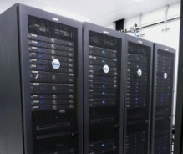


IP Targeting to Businesses
1
2
Lenovo wants to target ads for its servers to IT decision-makers at companies with 1,000+ employees
Fender Guitars
MSC Shipping Co.
Hearst Publishing
McKinsey Consulting
… and more
Lenovo’s sales team lists hundreds of target companies to approach, or existing customers to up-sell
4
3
Show ads targeting the IP addresses for all companies on Lenovo’s List
Result: Align sales and marketing by targeting only employees of potential or current customers
Lenovo Sales Prospects
10.16.1.250
10.16.1.251
10.16.1.260
11.34.2.388
11.34.2.400
10.16.3.500

Slide 21
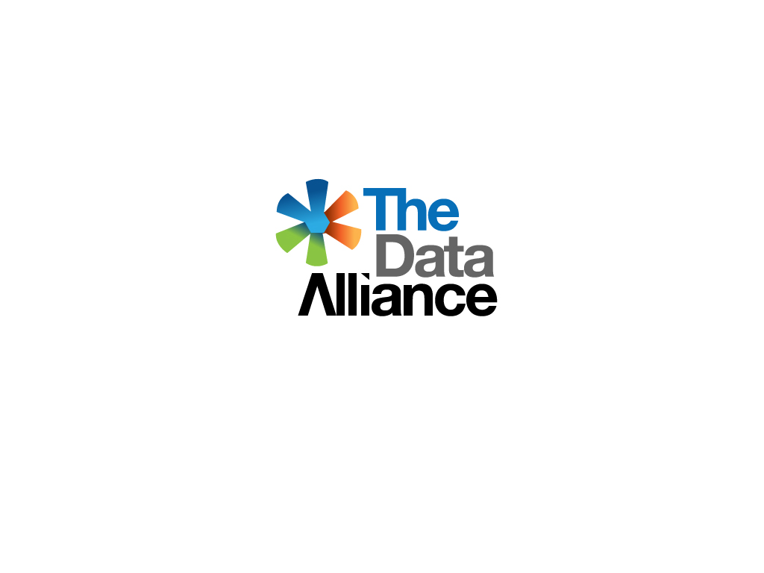
Cost Effective Use of Third Party Data
          Audience data from top online data companies
          Pricing as Percentage of CPM, instead of CPM fee
          Typical audience data cost of 10% - 25%
          For FBX campaigns, the most cost-effective way to use audience data
          $0.50 CPM on FBX + 10% data = $0.50 + $0.05
  Use a DSP that provides access to many 3rd party data segments with more cost-effective pricing via The Data Alliance – A Revenue Share Price Model is used instead of a Flat CPM rate which essentially drives up cost and eclipses performance

Slide 22
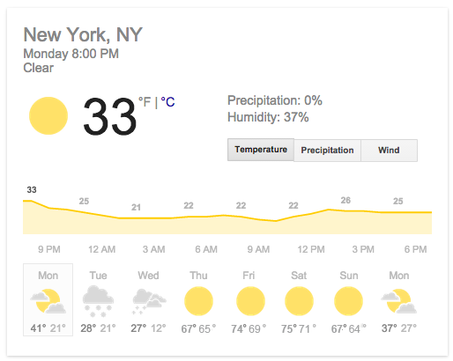
Temperature Targeting
Take real-time weather data for every location on the planet and target ads accordingly.
Air conditioner ads during a heat-wave in Australia. Food delivery ads for cold nights in NYC.
What is more relevant to a person than their environment?
Target users when the temperature rises or falls within a pre-determined band to connect with audiences more likely to convert.
For campaigns that offer cold- or warm- weather specific
products such as outer wear or ice cream, this targeting
strategy is a must have!
Capitalize on campaign insights:
  Confirm expected results
  Understand unexpected user behavior
  Gain deep insights into conversion patterns of users
Maximize the opportunity to sell temperature-specific products during expected and unexpected spikes in temperature.

Slide 23

Case Study – Retargeting Alongside New User Prospecting
Client Type: E-Commerce
Campaign Performance before and after implementing a Prospecting campaign that ran alongside our Retargeting campaign:
Campaign Results:
Based on the 400% ROAS objective, campaign performance was 130% higher than the set ROAS goal, with a very considerable CTR lift. This significant boost for the After Prospecting Campaign came in despite having $1k less in budget.
In addition to boosting the results of our Retargeting campaign, the Prospecting campaign helped grow the cookie pool at rate of approximately 4000 cookies a day – More than 31,000 cookies within 9 days.
Retargeting Before Prospecting:
Goal: 400% ROAS
Spend: $12k
PC Conversions: 127
PV Conversions: 1,918
CTR: 0.07%
ROAS: 839%
Retargeting After Prospecting:
Goal: 400% ROAS
Spend: $11k
PC Conversions: 109
PV Conversions: 2,120
CTR: 0.12%
ROAS: 919%

Slide 24
OTHER TYPES OF DISPLAY
Beyond the Norm

Slide 25
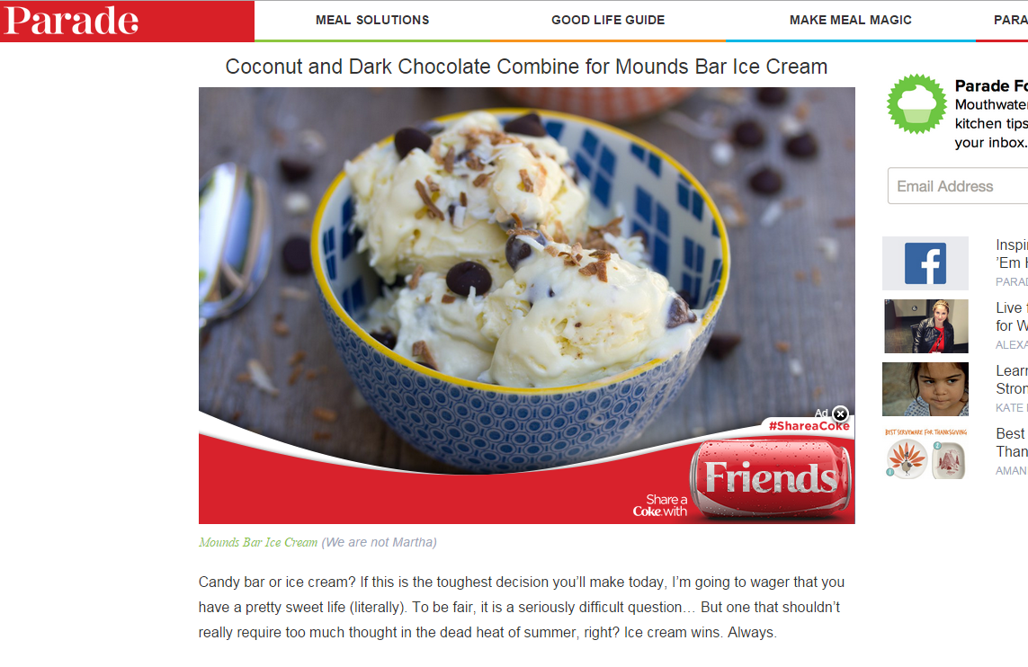
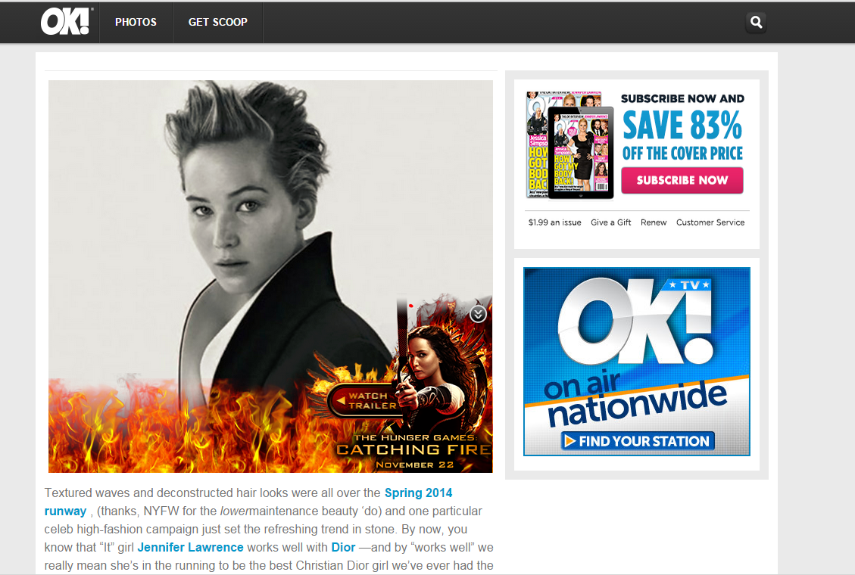
Custom Ad Units Increase Engagement

Slide 26
Private Marketplace
We can execute Guaranteed Premium buys and launch it Programmatically.
For example, if buying CNN.com inventory through the PMP, you can optimize the campaign with all levers available through RTB buys. I.e.: Day of Week, Time of Day, etc. It is not possible to granularly optimize this way directly through the Publisher
Use audience data to reach your target demo at scale on premium sites.
Application of global frequency cap across all channels and publishers
Transparency, data and ability to optimize placements afforded by a DSP
See how premium publishers falls into the larger attribution picture

Slide 27













Mobile Ad Exchanges
ONGOING INTEGRATIONS
CURRENT PARTNERS
NAMES TO LISTEN FOR

Slide 28
REPORTING
Granular Data

Slide 29
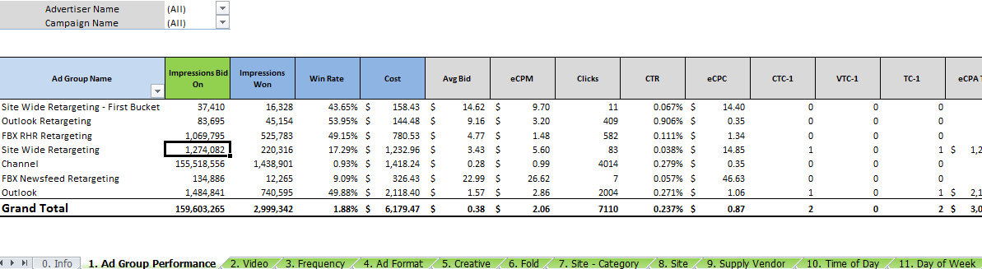
Granular Reporting
Comprehensive Display Reporting through the High Definition (HD) Report

Slide 30
Granularity Defined
1. Performance
Great for viewing general stats by day and by ad group/campaign
2. Video
For viewing video stat performance by creative
3. Frequency
For viewing performance across frequency. Great for click based optimization campaigns
4. Ad Format
For viewing performance across ad format
5. Creative
For viewing performance by creative. Pull in ad format to help organize
6. Fold
For viewing performance by fold placement, Above/Below Fold
7. Site Category
If running on a whitelist or running contextual targeting, see performance for every site on this tab
8. Site
Go here for any site optimizations – Blacklisting sites that are not performing
9. Supply Vendor
For viewing performance by supply vendor
10. Time of Day
Reporting in the user’s time of day – really powerful for optimizing and story telling
11. Day of Week
Reporting in the user’s day of week – look at performance of weekends against weekdays
12. Browser
Performance by browser – pull in device type or operating system
13. Device Type
Performance by device type – pull in browser or operating system
14. Recency
Really powerful tab for optimizing retargeting ad groups as we increase/lower bids on specific cookies
15. Elements
Reporting at the data element level inside of an audience. Really great for BT campaigns!
16. Language
For viewing performance across the languages used in the browser

Slide 31
VIDEO ADVERTISING
Including Advanced TV

Slide 32
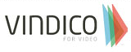















Access to Large Video Audiences
A Single Video Ad Network is not enough. Don’t limit your video campaigns to one slice of the universe
Video networks are also taking large, non-transparent fees
From public financial statements
  Tremor: 41% average fee
  TubeMogul: 72% average fee

Slide 33
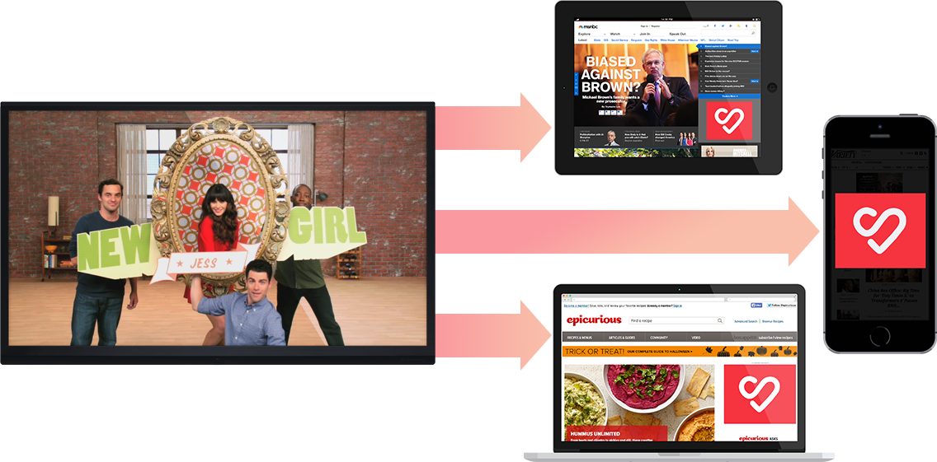


Samba: TV Advertising Is Now Cross-Screen
Extend Reach. Retarget and Reinforce. Programmatically.
77% of TV viewers use another device while watching TV.
  Samba TV viewership data allows you to reach your audience more effectively across screens
  Target your audience based on exposure to a show, commercial or viewing history
  Reinforce your messaging or share your competitive response on every other device in the household
  Samba TV is offering it’s data on a % of CPM pricing model for significant advertiser savings
Samba’s patented technology instantly and seamlessly synchronizes all screens to deliver the most valuable TV context for your brand.

Slide 34












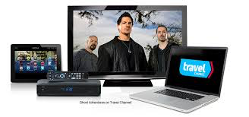
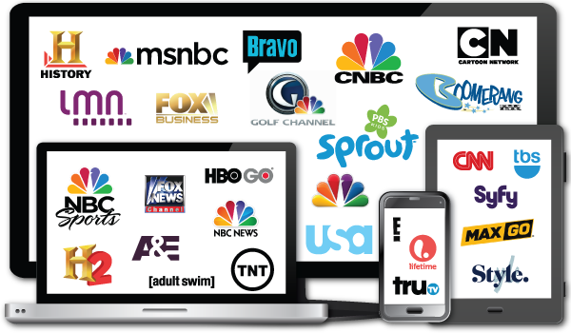





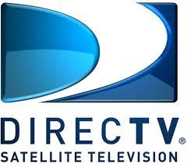















What’s on the Horizon…
ADVANCED TV
TV EVERYWHERE
BROADCAST TV
(Current and Future Integrations)

Slide 35
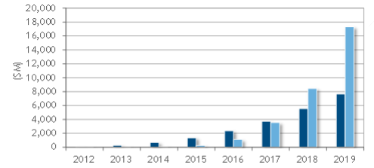
Worldwide Programmatic TV and Video Advertising Spending

Slide 36
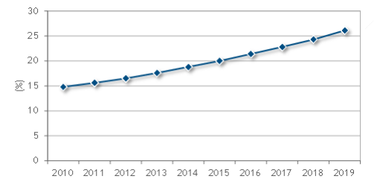
Share of U.S. Households Without Cable, Satellite or Telco TV Subscription

Slide 37
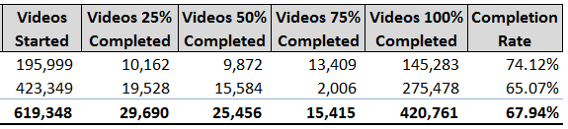
Video View Metrics
Provide In-Depth Video Engagement Metrics, like Video starts, Quartile Completions and Completion Rates
View performance for video and display in one single report
Same granularity as display reporting

Slide 38
WRAPPING UP
What Else is Important

Slide 39
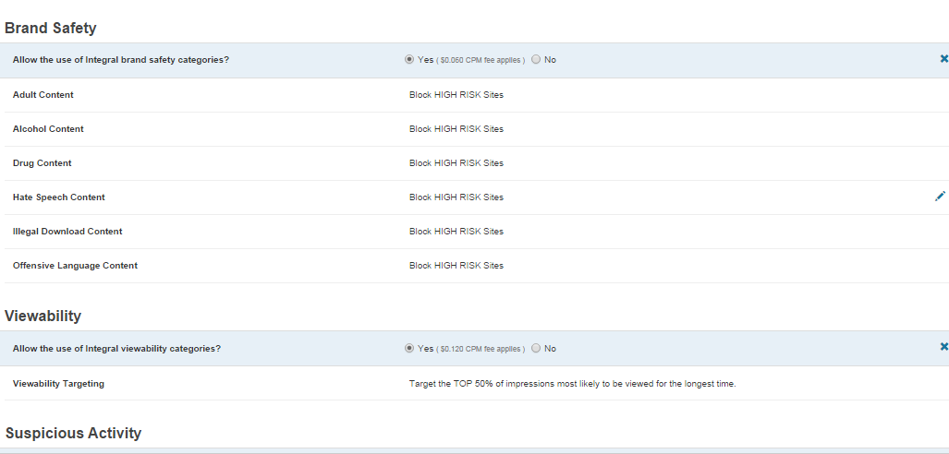
Brand Safety & Suspicious Activity
Despite growing measures toward ensuring RTB quality traffic, the universe is so vast that it’s sometimes risky to only run with a Global Block List.
The Global Block List is updated by continually removing any offending IP Addresses or URL’s, yet when your Brand’s reputation is on the line, it is highly recommend to incorporate additional premium traffic filter measures including Brand Safety Features, Viewability and Suspicious Activity.
New Brand Safety Features does not allow any Adult, Alcohol, Drug, Hate Speech, Illegal Download or Offensive Language Content to come into contact with your client’s Brand
Viewability targets the Top 10-75% of Impressions most likely to be viewed for the longest time
Suspicious Activity Blocks Very High Risk sites above and beyond the Block Lists which are already in place.

Slide 40
Display Media Differentiators
Direct Publisher
Frequency Transparent
Unique Recency Data
High Definition Reporting
Low Commitment IO’s
Data Alliance
NOT an Ad Network. When you're not dealing direct, you will likely incur additional 'middleman' fees. Access a large digital marketing footprint and connect with all the major ad exchanges including the Facebook Exchange
Unique in our ability to optimize Frequency. We are not a black box outfit, but one that is transparent and sets realistic frequency caps. Black box frequency capping can easily result in ad fatigue or worse, user annoyance!
Recency is data uniquely reflected in our reporting. We can bid on cookies that are more valuable as they convert and lower bid multipliers on those that don’t. This decreases CPA and increases performance as we maximize budget potential
Our reports are the most comprehensive in the industry with over 16 tabs of data. The data is used to optimize campaigns on a granular level and includes Ad Group, Frequency, Site Vertical, Site List, Creative, Fold, Exchange, Time of Day, Day of Week, etc
We are confident to show results quickly. Mid-size clients are very attracted by this low risk element. Work on a month to month basis and don’t require a large dedicated spend. Retargeting Only = $2500/Mo. and Channel + Retargeting = $5k/Mo.
DA allows the growing of small cookie pools without solely relying on New User Prospecting

Slide 41
CASE STUDY
Wellington Fragrance

Slide 42

Wellington Fragrance Case Study
Client Type: Online Fragrance Oil E-Commerce Website
Campaign running in North America
Campaign Results:
Campaign Scope: 5.5 months to date
Goal: Low CPA and High ROAS
Overall CPA: $7.33
Overall ROAS: 1355%
Please note these metrics reflect the campaign from March 13th, 2015 onwards, when we started tracking conversion data.

Slide 43
Methodology
Client Type: Online Fragrance Oil E-Commerce Website
Campaign running in North America
Strategies Used:
Site Wide Retargeting: Retargeting anyone who’s visited the Wellington Fragrance website with display ads anywhere else on the internet.
Shop Cart Retargeting: Retargeting anyone who’s visited the Wellington Fragrance Shop Cart with display ads anywhere else on the internet.
Household Extension Retargeting: If a consumer visits the Wellington Fragrance website on a desktop, anyone in that IP address will be retargeted on any other device (tablet, mobile, other laptops, etc…)
Converted Users Retargeting: Retargeting anyone who’s purchased something on the Wellington Fragrance website with display ads anywhere else on the internet.
Outlook Retargeting: Retargeting anyone who’s visited the Wellington Fragrance website with display ads on their Outlook.com account.
Shop Cart Retargeting – First Bucket: Retargeting anyone who’s visited the Wellington Fragrance Shop Cart with display ads anywhere else on the internet ONLY 12 hours since they’ve left the Shop Cart.
Site Wide Retargeting – First Bucket: Retargeting anyone who’s visited the Wellington Fragrance website with display ads anywhere else on the internet ONLY 12 hours since they’ve left the Wellington Fragrance website.

Slide 44
Findings
Client Type: Online Fragrance Oil E-Commerce Website
Campaign running in North America
The best performing ad group in terms of CPA was Shop Cart – First Bucket, coming in at $7.24. However, Converted User Retargeting had the highest ROAS with an overall of 2778%, almost twice the ROAS of the next closest strategy. Converted Users Retargeting is able to almost double to revenue per sale compared to the Shop Cart – First Bucket, which is still pulling in a 1400% ROAS.
The best performing creative was the 300x250 with a CPA of $9.50, followed closely by the 728x90 and the 160x600 respectively.
The best Supply Vendors for the campaign were FederatedMedia, Google, Rightmedia and AppNexus, with CPAs of $4.98, $7.14, $7.28 and $8.00 respectively.
The most productive Times of Day were 10 and 11 am, with ROAS’ of 1899% and 2338% respectively. 9 PM was productive as well, with an ROAS of 1823%.
Friday was the best Day of Week, with an ROAS of 2112%. Coming in second was Sunday, with an ROAS of 1549%. The ROAS’ over the weekend were generally better than the results over the course of the week, as we normally see with most E-Commerce campaigns, and the campaign was optimized with that in mind.
The two best browsers consumers purchased on were Firefox, with a CPA of $8.84, and Internet Explorer 11 with a CPA of $9.80.
Most of the spend (more than 95%) came from Desktops and the campaign was optimized with that in mind.
In terms of Recency, the most productive segments were the First 12 hour buckets, which were exclusively targeted using the First Bucket strategies. Bids were tapered off as the cookies grew older in all other strategies.
Geo optimization was used in this campaign. Bids were increased in geos such as Texas, Arizona, Pennsylvania, Vermont and Connecticut where results were strong.

Slide 45
End of the Day – The Meat !

Slide 46
End of the Year – 12 mos. for this Case!
Brand Growth Achievements – Sept 2014 through Aug 2015 – 57.75%
in terms of Revenue Measurement

Slide 47
Questions?
Ben Smith
basmith@wsiwebsuccess.com
262-898-7142 x112

